Slide 1
Credit Card Customer Analysis
Alexa Mavica
Saksham Bansal
Neel Patel
Gopika Sushrut Chaudhary
Sahil Yadav
BIA 500: Business Analytics
Professor Bei Yan
Spring 2022

Slide 2
Presentation Outline
Problem Statement
Dataset Overview
Analytical Approach
Findings Experiment 1
Key Variables
Findings Experiment 2
Findings Experiment 3
Interpretations and Recommendations

Slide 3


Problem Statement
Banks are spending a considerable amount of money trying to offer digital services and other amenities to new and existing customers; however, customer churning rates have continued to rise. With increased churning rates impacting revenue and profitability of banks, there has been major concerns about how to determine which customers will churn as well as how to lower to rate of churning. By evaluating if there is a relationship between gender and churning rates and determining which variables are most significant predictors of churning bank, managers are confident that customer churning rates will decrease and overall profitability will increase.

Slide 4

Dataset Overview
The dataset used in this analysis was collected in 2021 and was sourced from Kaggle. The dataset is a representation of customers who use credit card services throughout the world and consists of 10,000 customers mentioning factors such as their age, salary, marital status, education level, gender, dependent amount, credit card limit, and credit card category. ​
This dataset shows 16.07% of customers have churned

Slide 5
Analytical Approach
We have chosen to conduct three analyses to describe our key variables:​
Rapid Miner
Used to determine correlation weightage of each variable with churning
Helps determine relevance of each variable in relation to churning
Chi-Squared Test
Conducted to check if gender plays a role in churning of a customer
Tell us if two categorical variables are independent or not
Regression
Provides information about what variables affect the churning rate
Determines which factors matter most, which can be ignored, and how the factors influence each other

Slide 6
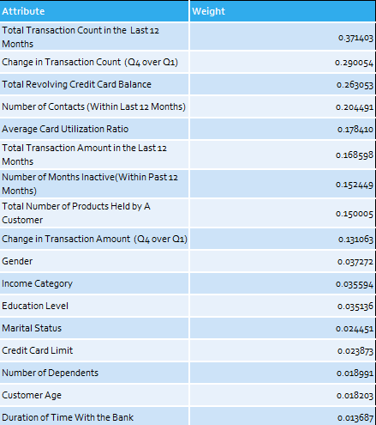
Findings Experiment 1: Correlation Weightage from Rapidminer
Conclusions:
Using the credit card customer data and determining correlation weightage in Rapidminer it can be concluded that the following variables have the highest correlation weightage:
Total Transaction Count in the Last 12 Months
Change in Transaction Count (Q4 over Q1)
Total Revolving Credit Card Balance
Number of Contacts (Within the Last 12 Months)

Slide 7
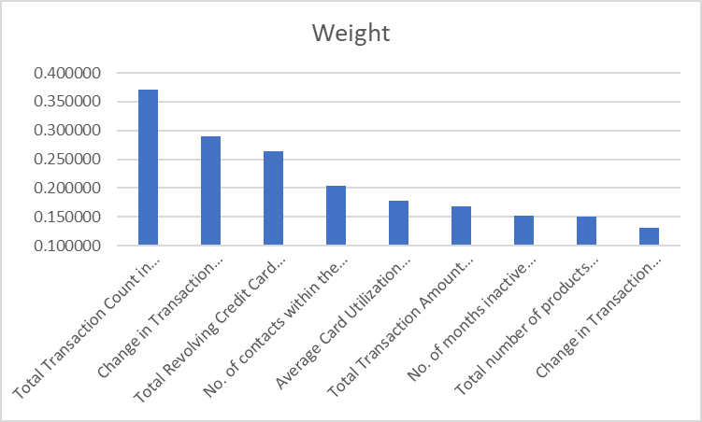
Key Variables

Slide 8
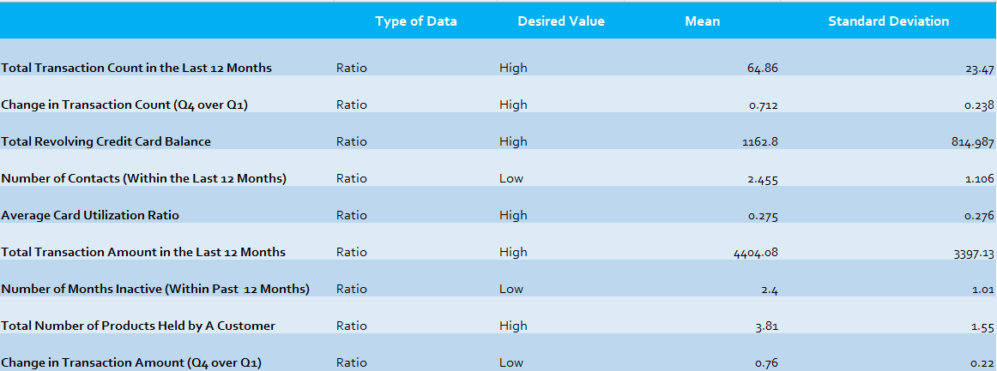
Key Variables

Slide 9
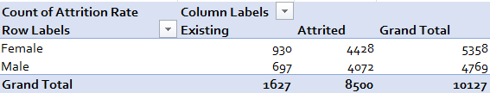
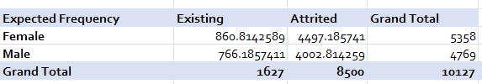
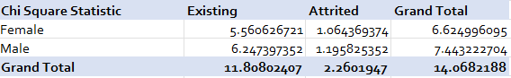
Findings Experiment 2: Chi-Square Test
Null (H0): Gender and churning are independent of each other
Alternative (H1): Gender and churning are dependent of each other
Pivot Table
Conclusions:
Since p-value is 0.000176298 which is less than 0.05 we reject the null and accept the alternative concluding that gender and churning are dependent
Expected Frequency
Chi-Square Statistic
P-Value from Chi-Square Test

Slide 10
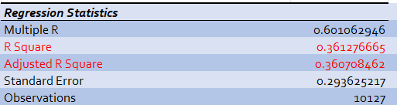
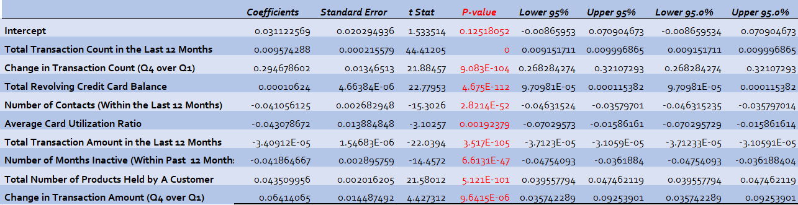
Findings Experiment 3: Regression
Null (H0): Total Transaction Count in the Last 12 Months, Change in Transaction Count (Q4 over Q1), Total Revolving Credit Card Balance, Number of Contacts (Within the Last 12 Months), Average Card Utilization Ratio, Total Transaction Amount in the Last 12 Months, Number of Months Inactive (Within Past 12 Months), Total Number of Products Held by A Customer. and Change in Transaction Amount (Q4 over Q1) are NOT significant predictors of whether a customer will churn or not.
Alternative (H1): Total Transaction Count in the Last 12 Months, Change in Transaction Count (Q4 over Q1), Total Revolving Credit Card Balance, Number of Contacts (Within the Last 12 Months), Average Card Utilization Ratio, Total Transaction Amount in the Last 12 Months, Number of Months Inactive (Within Past 12 Months), Total Number of Products Held by A Customer. and Change in Transaction Amount (Q4 over Q1) are significant predictors of whether a customer will churn or not.
Conclusions:
When looking at the r squared value and the adjusted r square value, we can note that the model that includes all variables has the largest R squared value of 0.3612767 and the largest adjusted squared value of 0.360708 therefore each of these nine variables are significant predictors of whether a customer will churn or not.

Slide 11
Interpretations and Recommendations
Gender’s Impact on Churning
Predictor Variables
The analysis performed showed that there was statistically significant evidence that gender affects has an effect on the customer churn rate for banks.
The regression model developed from our analysis showed that there was statistically significant evidence that all nine variables with the highest correlation with attrition are important predictors of churning customers.
Based on the analyses performed we have found statistically significant evidence that nine key variables are all significant in predicting churning customers and that gender in has an impact on churning customers. From these conclusions, we recommend that banks focus less on the duration of time with the bank, customer age, credit card limit, and number of dependents and instead look at factors such as total transaction count in the last 12 months, change in transaction count, total revolving credit card balance, and other key variables noted to predict churning customers. Overall, these variables that relate to the activity of a customer within a year period are going to be most accurate for bank manager, and strategies for engagements with the client should be centered around these factors to prevent them from churning.

Slide 12
Thank You
Questions?

